Slide 1

Urun Public Opinion Big Data Analysis Platform
全新源覆盖 多维智能分析 热敏舆情预警
Urun Public Opinion Big Data Service LTD.
Notes:
Urun Public Opinion Big Data Analysis Platform

Slide 2

Urun Introduction

Slide 3

Urun Introuduction
A
Aritificial intelligence
Deep Learning, NLP, A/V analysis
AI
Big Data
Destributed crawling, the biggest global multi-language media database with a data repository of over 50PB in size.
UrunDP is the all-in-one big data processing platform. UrunExplorer is an intuitive data mining platform. UrunSoon is the next-generation big data visualization platform. AI-based Recommendation Engine. Big-data Search Engine, Big data security, and big data in-a-box solution.
B
Big data
C
Cloud
virtualization platform, private cloud, public cloud, cloud desktop
Cloud
D
Engerprise-level Software Development
uDev is a revolutionary automatic software generation methodology and platform.
Unrun
Development
Notes:
AI Aritificial intelligence: Deep Learning, NLP, A/V analysis
Big Data: Destributed crawling, the biggest global multi-language media database with a data repository of over 50PB in size.
UrunDP is the all-in-one big data processing platform. UrunExplorer is an intuitive data mining platform. UrunSoon is the next-generation big data visualization platform. AI-based Recommendation Engine. Big-data Search Engine, Big data security, and big data in-a-box solution.
Cloud: virtualization platform, private cloud, public cloud, cloud desktop
Engerprise-level Software Development: uDev is a revolutionary automatic software generation methodology and platform.
Unrun

Slide 4

All sorts of honors and qualifications, among them the CMMI3 compliance and ISO 20000 and ISO 27001, ISO 9001 form information project management, security and quality control. AAA grading for enterprise credibility.
Notes:
All sorts of honors and qualifications, among them the CMMI3 compliance and ISO 20000 and ISO 27001, ISO 9001 form information project management, security and quality control. AAA grading for enterprise credibility.

Slide 5
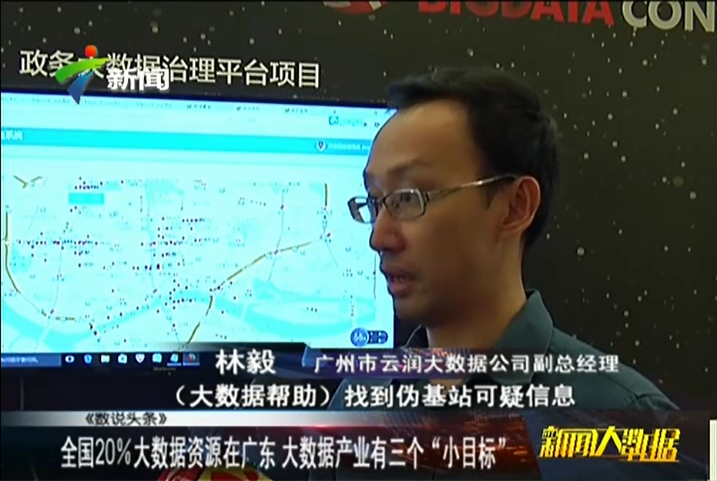
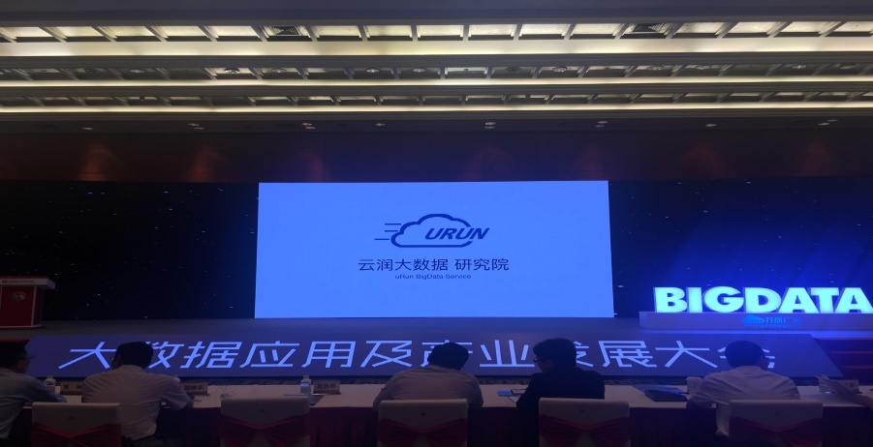
Urun in Media
The national Big Data Summit 2016 in Guangzhou
公司领导接受电视台采访
优秀企业展示
Notes:
The national Big Data Summit 2016 in Guangzhou

Slide 6
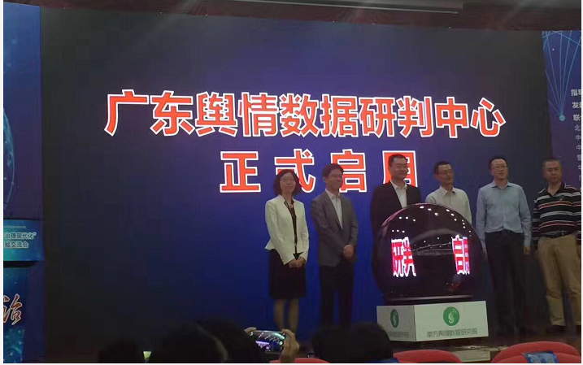
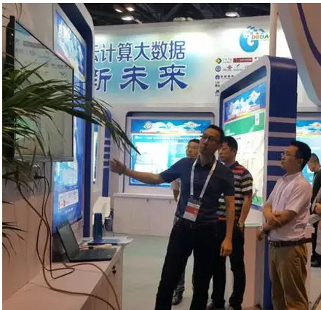
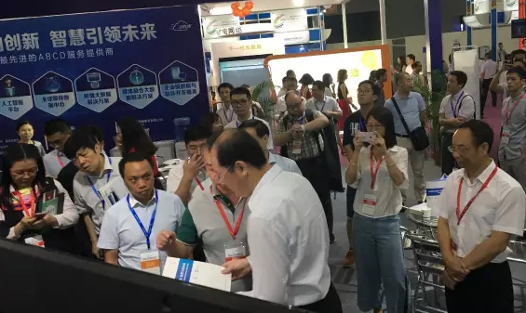
Various announcemnts and showcases of new products, services and partnership.
Notes:
Various announcemnts and showcases of new products, services and partnership.

Slide 7
Product Line
Personalized recommendation engine
Virtualization and cloud desktop
Data crawling, processing, analysis and visualization
Application in various vertical markets
Notes:
Virtualization and cloud desktop
Data crawling, processing, analysis and visualization
Personalized recommendation engine
Application in various vertical markets

Slide 8
Urun Advantages
Technology advantages
Comprehensive technology and service ability in all aspects, including ABC, search engine, IOT, recommendation engine, block chain.
uDev software generation technology.
Data advantages
The largest public opinion search engine in China.
Owned and managed many data centers.
Over 12 years of big data experience in Internet contents and public opinions, Global Media contents, e-commerce and think-tanks.
Technology
Data
Urun
Reputation
Team
Reputation and cases
Hundreds of enterprise customers, including governments, state-owned companies and private companies.
Excellent reputation and doubled revenue in the past years.
Excellent team
Team leaders from top internet companies
Collaboration with top universities
Mature project implementation management
Notes:
Technology advantages:
Comprehensive technology and service ability in all aspects, including ABC, search engine, IOT, recommendation engine, block chain.
uDev software generation technology.
Reputation and cases:
Hundreds of enterprise customers, including governments, state-owned companies and private companies.
Excellent reputation and doubled revenue in the past years.
Data advantages:
The largest public opinion search engine in China.
Owned and managed many data centers.
Over 12 years of big data experience in Internet contents and public opinions, Global Media contents, e-commerce and think-tanks.
Excellent team:
Team leaders from top internet companies
Collaboration with top universities
Mature project implementation management

Slide 9
Urun Technical Solutions

Slide 10
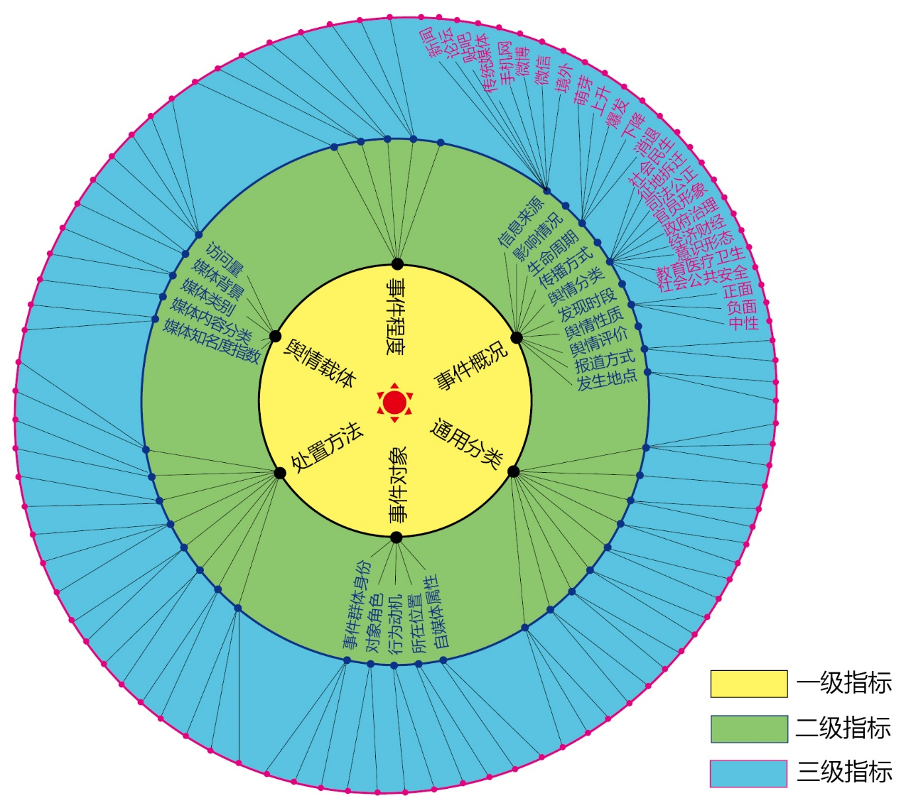
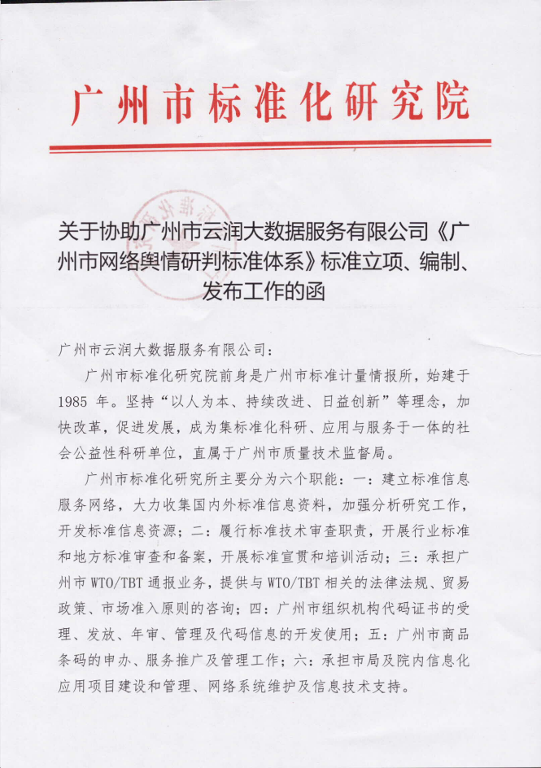
Published first ever public opinion management standard in CHINA
Notes:
Published the country’s first ever standard in public opinion management

Slide 11
A look at the life cycle of public opinion crisis
Recession period
Inactive period
Mature period
Incubating period
Explosive period
Notes:
A look at the life cycle of public opinion crisis
Inactive period
Incubating period
Explosive period
Mature period
Recession period

Slide 12
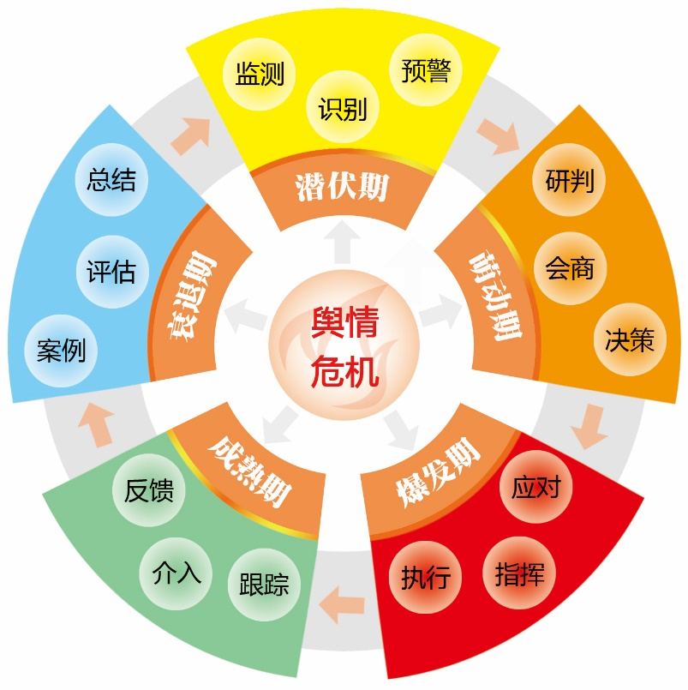
The Public Opinion Risk Management Theory
Based upon years of theorectical study and real-life public opinion handling experience, URUN has developed a complete system in public opinion risk management, including theory and the supporting software solution.
Discovery and
Alerts
Reviews and reports
Analysis
and
Decision Making
Evaluation of results and
feedback
Neutralization
and
diversion
Notes:
The Public Opinion Risk Management Theory
Based upon years of theorectical study and real-life public opinion handling experience, URUN has developed a complete system in public opinion risk management, including theory and the supporting software solution.
Discovery and Alerts
Analysis and Decision Making
Neutralization and diversion
Evaluation of results and feedback
Reviews and reports

Slide 13






URUN public opinion solution
Inactive period：
Monitoring
Identification
Alerts
Incubating period：
Aanalysis
Conference
Decision making
Notes:
URUN public opinion solution
Inactive period:
Monitoring
Identification
Alerts
Incubating period:
Aanalysis
Conference
Decision making

Slide 14









Explosive period:
Counter-measures
Commands and communications
Execution
Mature period:
Tracking
Interference
Feedback
Recession period:
Case study
Evaluation
Reviews and reports
Notes:
Explosive period:
Counter-measures
Commands and communications
Execution
Mature period:
Tracking
Interference
Feedback
Recession period:
Case study
Evaluation
Reviews and reports

Slide 15
Technology Architecture
User services layer
Application layer
Business logic and processing layer
Data collection layer
Sources of information layer
Notes:
User services layer
Application layer
Business logic and processing layer
Data collection layer
Sources of information layer

Slide 16

URUN Public Opinion Product Features
Cutting Edge Technologies
24/7 Data Monitoring & Collection
CROSS CHANNEL Data Gathering(news, forums, news paper, social network platforms)
MULTI-LANGUAGE 15+ language supported in data collection
RELIABILITY secured by World Class In House Data Center
100 MM + pieces of information retrieval everyday
50 PB Accumulated Data
Collaborate Artificial Intelligence, Big Data and Cloud Computing
Notes:
URUN product advantages:
Broad coverage of sources of informations: with thousands of data servers and ten times more data collection servers, URUN’s search engine monitors and crawls around the clock, with over 100 million pieces of information retrieval daily and over 50 PB data in accumulation.
Cutting edge technologies
This is self-explanatary

Slide 17

URUN Public Opinion Product Features
One Stop Public Opinion Analysis Platform
FULLY INTEGRATED PLATFORM
Public Opinion Inforamtion Monitoring
Data Screening & Collection
Hot Topical Sensitive Topical Alerts (available in multi-channel)
USER EXPERIENCE
Dynamic Reports
Highly customized Dashboard
Revamped User Interface
Notes:
URUN product advantages:
Broad coverage of sources of informations: with thousands of data servers and ten times more data collection servers, URUN’s search engine monitors and crawls around the clock, with over 100 million pieces of information retrieval daily and over 50 PB data in accumulation.
Cutting edge technologies
This is self-explanatary

Slide 18
Urun Core Business Introduction

Slide 19
The largest public opinion search engine in China.
汉语、藏语、蒙语、英语、法语、德语、俄语、日语、韩语、西班牙语、阿拉伯语等80多个语种
新华网、光明网、人民网、中国新闻网、中国广播网、新浪网、搜狐网、网易网、腾讯网、法制网、中青网、大渝网、金羊网、新民网、中安在线、商都网、中青在线、荆楚网、中华网、环球网、21CN、北青网、头条新闻、上海观察、中国西藏网、新疆新闻网、凤凰网、齐鲁网、山西新闻网、求是网、其它新闻网站等
50PB
32.4PB
互联网资讯
新浪微博、腾讯微博、微信公众号、新闻客户端、东方头条、搜狐、百度新闻、新浪、腾讯、网易、天涯社区、人民网、凤凰网、央视网等
10.69PB
两微一端
7.4PB
海外外文数据
CCTV视频、AcFun、爱奇艺视频、土豆视频、腾讯视频、福建电视台、西江传媒、凤凰视频、各地方电视台网站、其它视频网站等
东楚论坛、天涯论坛、红网论坛、二千沙龙社区、凯迪社区、西秦会馆、刷刷论坛、新华网发展论坛、百度贴吧、番禺业主论坛、人民网强国论坛、时空社区、济源论坛、东湖社区、长城论坛、红豆社区、猫扑大杂烩、其它地方论坛/社区/贴吧等
明报、东网、苹果日报、明镜网、香港东网、东方日报、亚洲周刊、文汇网、大公网、香港商报、镜报、香港太阳报、TVB新闻、香港电台、澳门日报、澳亚卫视、其它港澳台媒体等
参考消息、中国青年报、人民日报、中国证券报、新民晚报、羊城晚报、财经时报、金融时报、CCTV、经济日报、其它纸媒等
Facebook、Twitter、华侨时报、多伦多在线、CNN英文、纽约时报中文网、纽约时报 、东方时报、印度时报、亚洲新闻网、印度斯坦时报、日本新华侨报网、半岛电视台、朝鲜日报、韩国中央日报、日本共同网 、路透社、俄罗斯之声中文网、泰晤士报、美联社、卫报、英国镜报、其它境外网站等
新闻
论坛、贴吧
境外媒体
纸媒
港澳台
视频
两微一端
多语种
100万+
新 闻
80万+
论坛、贴吧
20万+
境 外
2000+
纸 媒
1万+
港澳台
8000+
视 频
4000万+
微博博主
1200万+
微信公众号
1000+
客户端
80+
多语种

Slide 20







Case Analysis
Trend Analysis
Impact Analysis
Data Mining
Hot Topic Analysis
Emotional Tendency Analysis
Typical Opinion Analysis

Slide 21
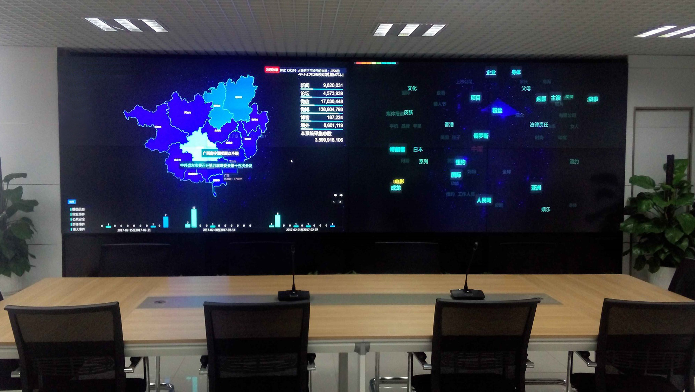
BIG SCREEN PRESENTATION & DECISION MAKING
Decision Making - DATA speaks louder than anything else
High Resolution Display
Real Time Dynamic Dashboards
Business Intelligence Reporting

Slide 22
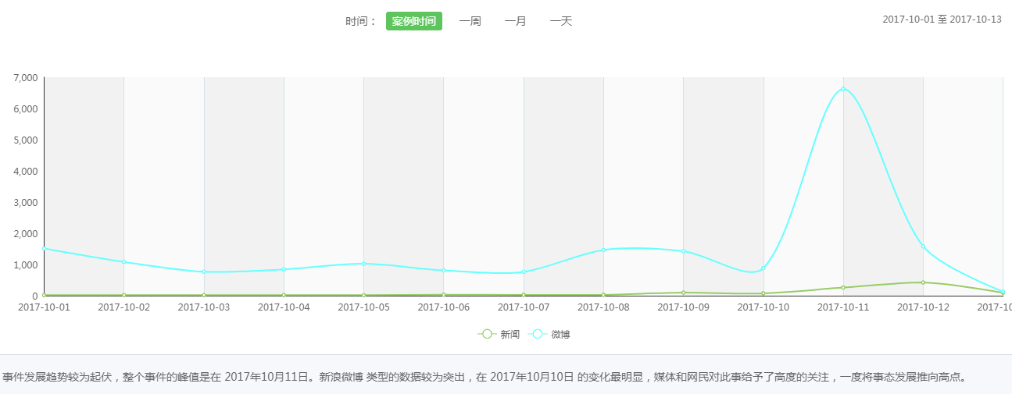
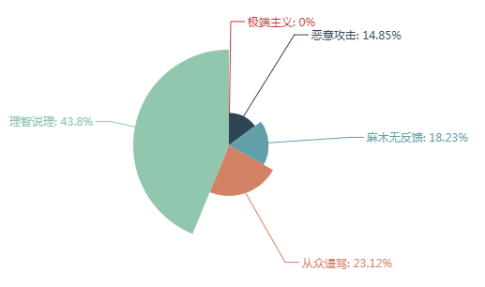
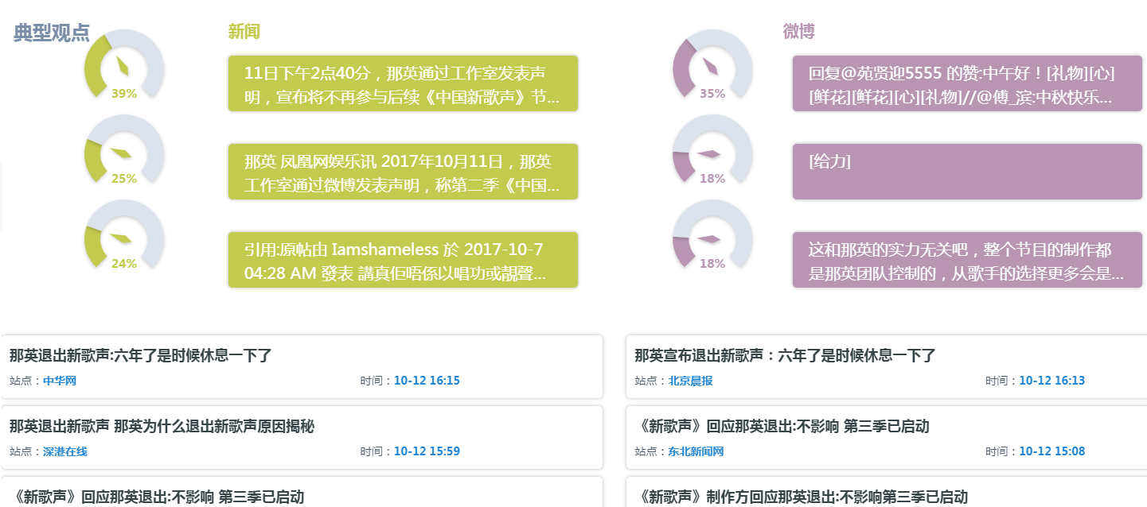
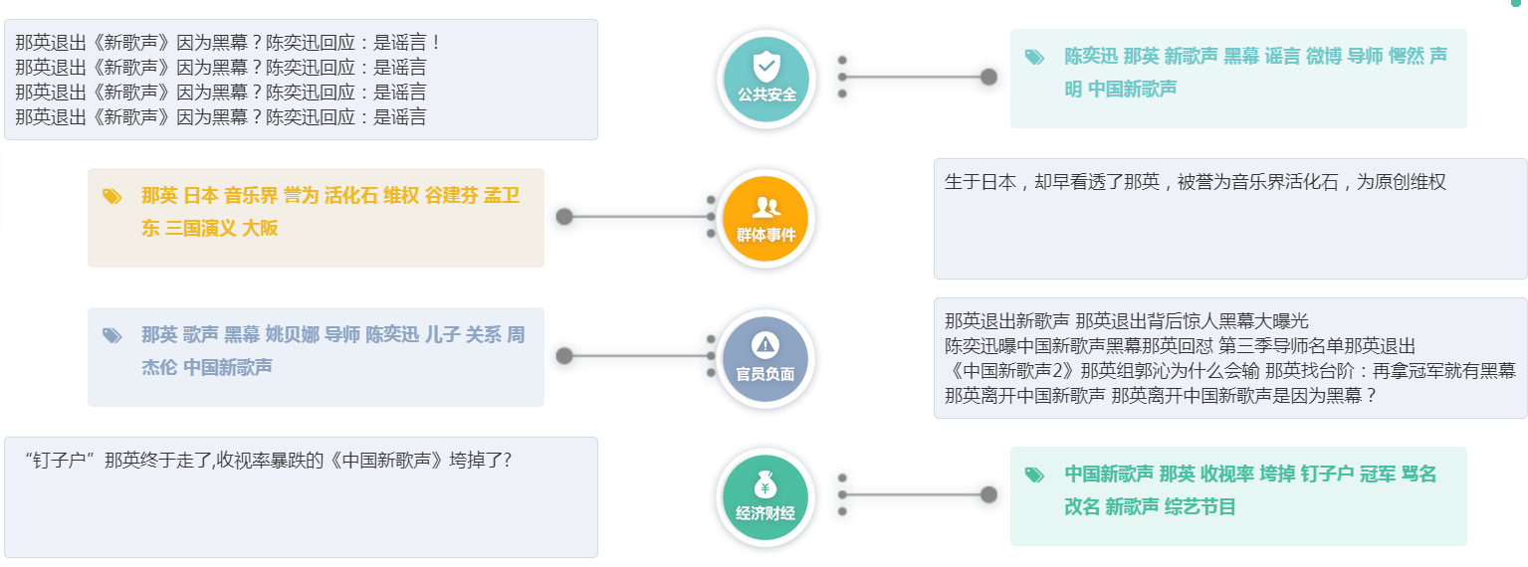
Visualization report automatic generation

Slide 23
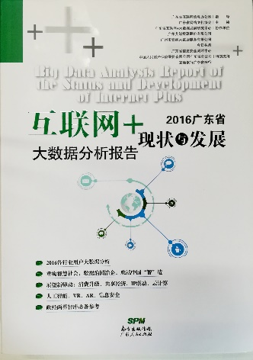


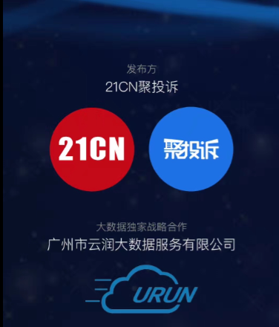
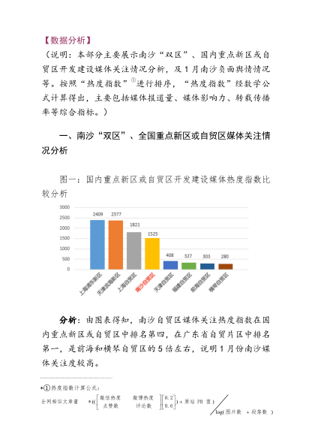
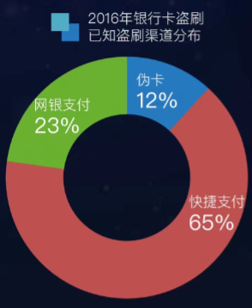
Artificial Intelligence Applied on Data Analysis Report

Slide 24
Urun Market Coverage

Slide 25
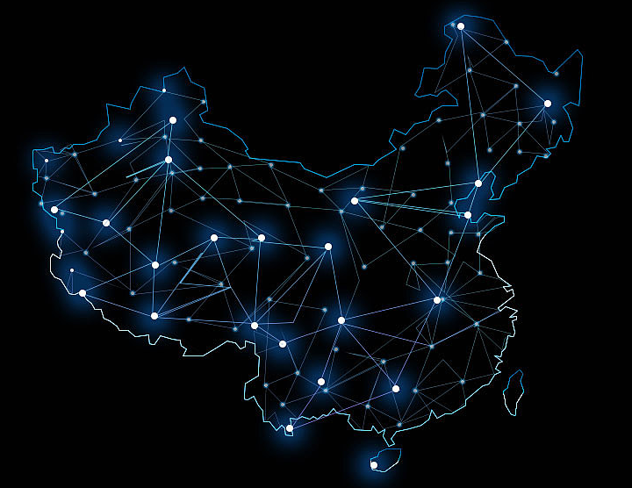
Urun Market Coverage
Our strategic partners include Govements branches , Colleges and Enterprises.

Slide 26

全新源覆盖 多维智能分析 热敏舆情预警
Web：www.urundata.com.cn
Tel：020-38620095

